Slide 1

AGENDA
What is Big Data
What is MapReduce
Azure Big Data Landscape
Enters Azure DWH

Slide 2

WHAT IS BIGDATA
Datasets whose size is beyond the ability of typical database software tools to capture, store, manage, and analyze.
Volume, velocity or variety of data is too great

Slide 3
WHAT IS MAP REDUCE
MapReduce is a programming model introduced by Google for processing and generating large data sets on clusters of computers.

Slide 4
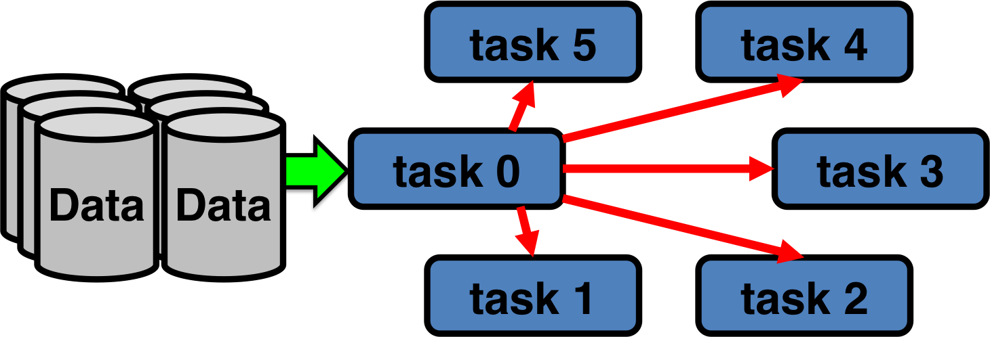
TRADITIONAL PARALLEL APPLICATIONS – brings data to compute
http://www.glennklockwood.com/data-intensive/hadoop/parallelism-traditional.png

Slide 5
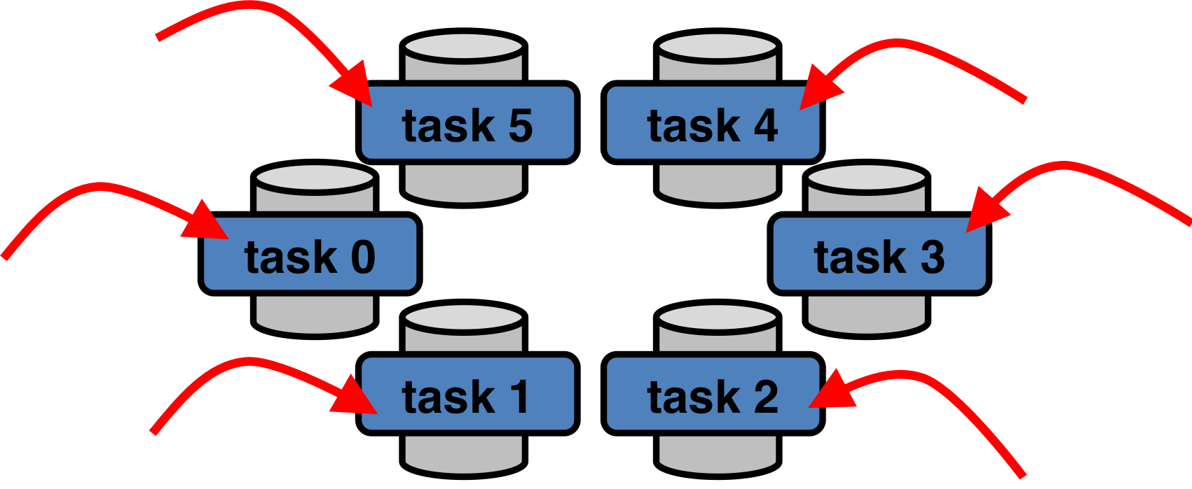
MAPREDUCE APPROACH – brings compute to data
http://www.glennklockwood.com/data-intensive/hadoop/parallelism-mapreduce.png

Slide 6
MAP REDUCE COMPONENTS
Map – works on a subset of data and aggregates it into tuples (key-value pairs)
Reduce – Uses the Map’s output and aggregates the tuples into a smaller set.

Slide 7
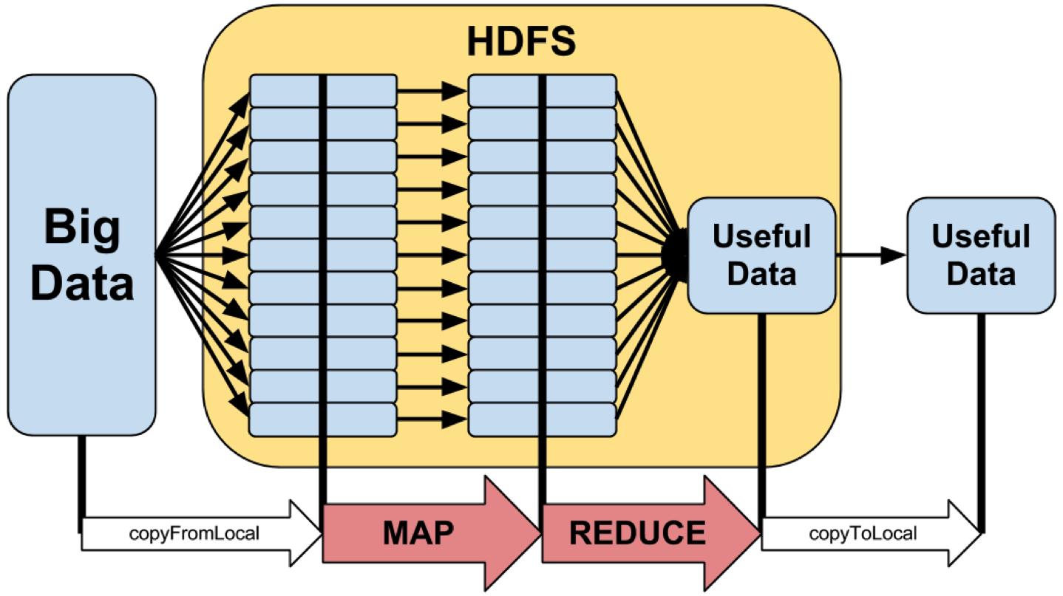
MAPREDUCE - THE BIG PICTURE
http://www.glennklockwood.com/data-intensive/hadoop/mapreduce-workflow.png

Slide 8
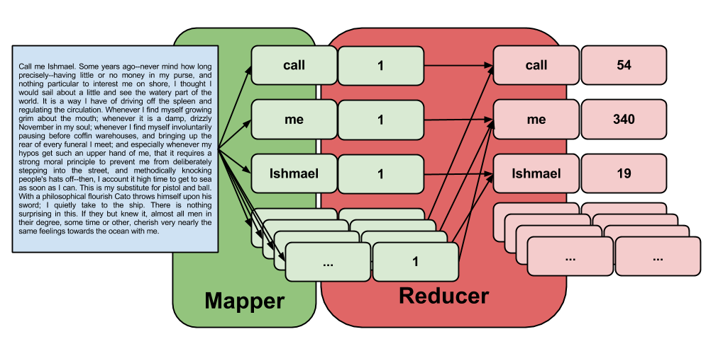
MAPREDUCE – CLASSICAL EXAMPLE
http://www.glennklockwood.com/data-intensive/hadoop/streaming.html

Slide 9
HADOOP
Distributed file system
Streaming
Ecosystem
Spark
Hive
….
All languages are welcome

Slide 10

AZURE BIG DATA LANSCAPE
HDInsight
Azure Data Lake Store
Azure Data Lake Analytics
Azure SQL Datawarehouse

Slide 11

KEY FEATURES
Massive parallel processing
Massively scalable
Enterprise-wide
Hyper-scale

Slide 12
HDInsight
Hadoop instance
Based on Hortonworks distribution
Features
Full redundancy
High availability
Data geo-replication
Extended security (including AD integration)

Slide 13
Azure Data Lake Store
Repository for BigData analytic
Hadoop compatible
Better performance
Additional own file system(adl://)

Slide 14
Azure Data Lake Analytics
An on-demand analytics job service
U-SQL
.NET
Python

Slide 15

AZURE SQL DATAWAREHOUSE
Architecture
Features

Slide 16
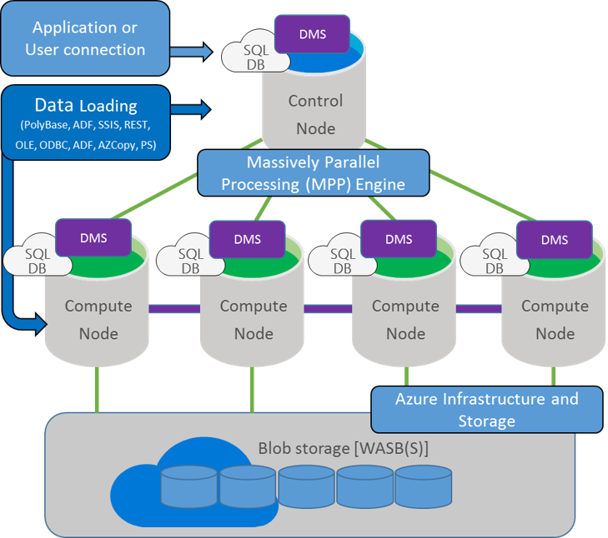
ARCHITECTURE

Slide 17

FEATURES
Combines the SQL Server relational database with Azure cloud scale-out capabilities.
Decouples storage from compute.
Enables increasing, decreasing, pausing, or resuming compute.
Integrates across the Azure platform.
Utilizes SQL Server Transact-SQL (T-SQL) and tools.
Complies with various legal and business security requirements

Slide 18
DISTRIBUTION
Behind the scenes, data is divided into 60 databases
Distribution methods
Hash Distribution - DISTRIBUTION = HASH([Key])
Round Robin – default
Each compute node has assigned distributions, in case of scale they are reassigned
Replicated Tables - DISTRIBUTION = REPLICATE
https://docs.microsoft.com/en-us/azure/sql-data-warehouse/sql-data-warehouse-tables-distribute

Slide 19
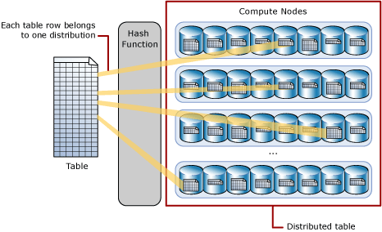
DISTRIBUTION

Slide 20
DISTRIBUTION CONSIDERATIONS
Hash column should not be updated
Distribute data evenly, to avoid data skew
Minimize data movement between nodes
Columns used in JOIN, GROUP BY, DISTINCT, OVER and HAVING clauses are good hash distribution candidates
Don’t Round Robin tables that will be joined

Slide 21
INTEGRATION
PolyBase
PowerBI
Azure ML
Azure analysis services
Excel
….
From outside it looks like SQL Database

Slide 22
PRICING
Compute – 100 DWU : 6000 DWU
Storage – Azure Premium Storage Pricing
Geo Redundancy - Azure Standard Disk read-access geo-redundant storage

Slide 23
SUMMARY
What is Big Data
What is MapReduce
Azure Big Data Landscape
Enters Azure DWH

Slide 24
TAKEAWAYS
Azure is a nice place for BigData
Whatever the expertise, there will be a right service

Slide 25

QUESTIONS??

Slide 26
THANK YOU

Slide 27

Nikolay Stanev Software advisor @ klearlending.com
nikolay@klearlending.com
https://www.linkedin.com/in/nikolaystanev/
https://twitter.com/nsstanev

